Slide 1
A brief introduction (revision) of
interrupt/exception

Slide 2



What is interrupt/exception?
Main ()
{
:
Doing something
(e.g.
browsing)
:
} ring
Phone rings
Can happen anytime
Depends on types of interrupts
_isr() //Interrupt service routine
{
some tasks (e.g. answer
telephone)
}//when finished,
//goes back to main
Phone rings

Slide 3
Examples
When your computer is running, a key press will trigger an interrupt to input a character to your system
The dispatcher in the operating system is implemented by timer interrupt.
  Timer interrupts the CPU at a rate of 1KHz
  At each interrupt the system determines which task to run next.

Slide 4
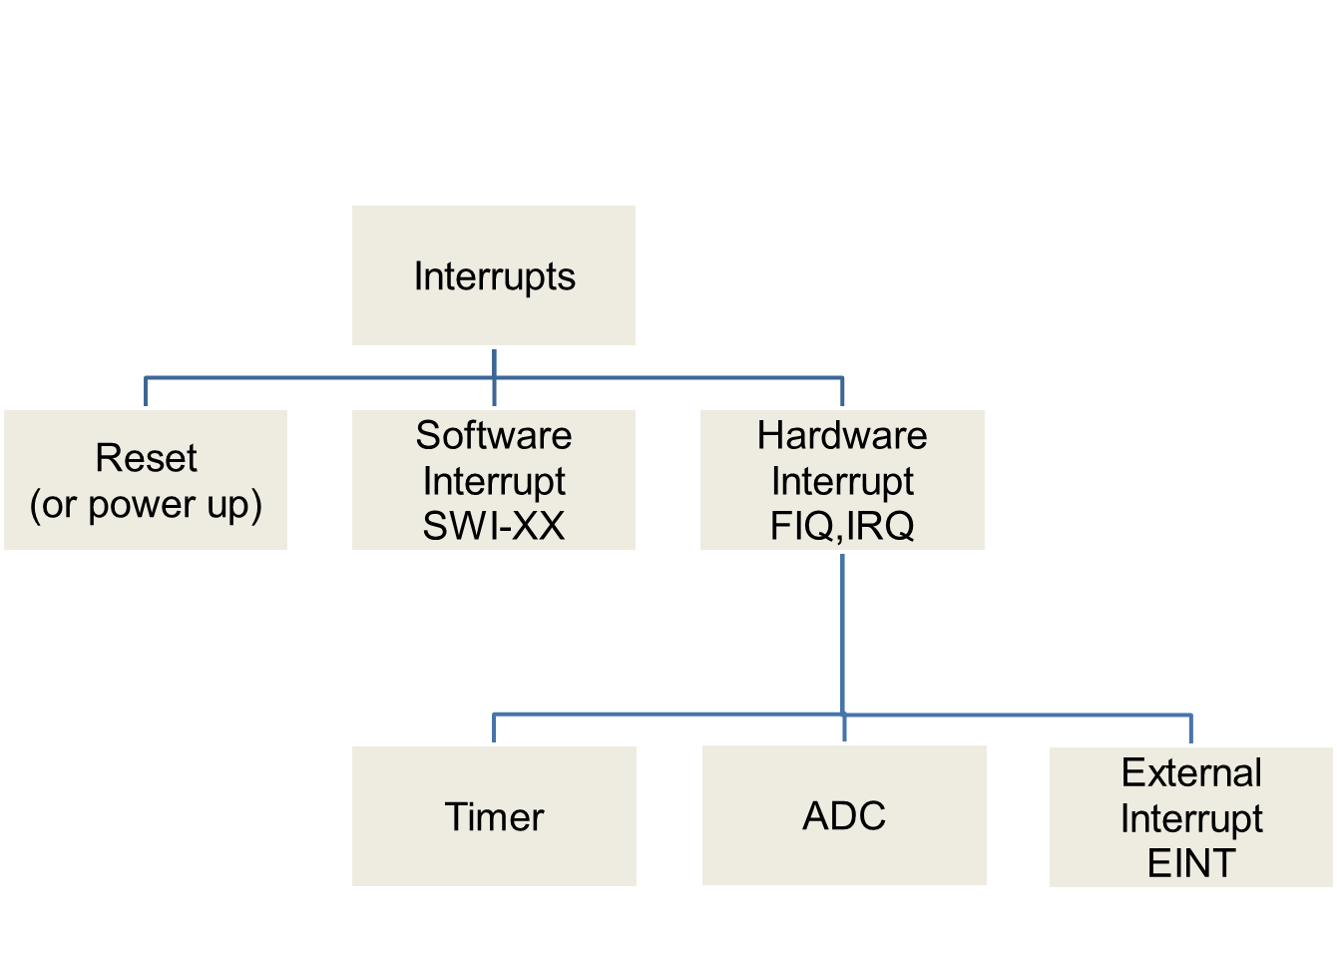
Important interrupts
SWI
Triggered by the software instruction SWI x
Triggered by hardware sources
Triggered by power_up/
reset_key

Slide 5
Interrupt and exception
The terms are used differently by various manufacturers
Traditionally exception means
  The normal operation of a program is interrupted and the processor will execute another piece of software (exception handling) somewhere.
    Interrupt (hardware interrupt) is an exception caused by some hardware condition happening outside the processor (e.g. external hard interrupt, IRQ FIQ).
    Software interrupt (SWI) is an exception caused by an assembly software instruction (SWI 0x?? exception call instruction) written in the software code.
    Trap is an exception caused by a failure condition of the processor (e.g. abort “pre-fetch , data” , undefined instruction, divided_by_zero, or stack overflow etc)

Slide 6
Important interrupts in words
Reset, a special interrupt to start the system– happens at power up , or reset button depressed)
Software interrupt SWI: similar to subroutine – happens when “SWI 0x??” is written in the program
Hardware interrupt
  FIQ (fast interrupt) or IRQ (external interrupt), when
    the external interrupt request pin is pulled low, or
    an analogue to digital conversion is completed, or
    A timer/counter has made a regular request
Inside LPC2131
Interrupt request generated
Timer/Counter
Counter overflow
Interrupt handling hardware
IRQ
ADC
End of conversion
FIQ
UART
End of transmission

Slide 7
Introduction to
Software Interrupt (SWI)

Slide 8
Compare hardware and software interrupt
  Hardware interrupt, e.g.
  Software interrupt
A falling edge at EINT3 will trigger the
execution of the interrupt service routine
__irq IRQ_Eint1()
IRQ_Eint1()
{
::
}
Computer
EINT3
Computer
Main{
:
SWI N
:
}
An instruction “SWI N” in
the program will trigger the
execution of
the N-th-sys-routine
(system routine)
N-th-sys-routine()
{
::
}

Slide 9
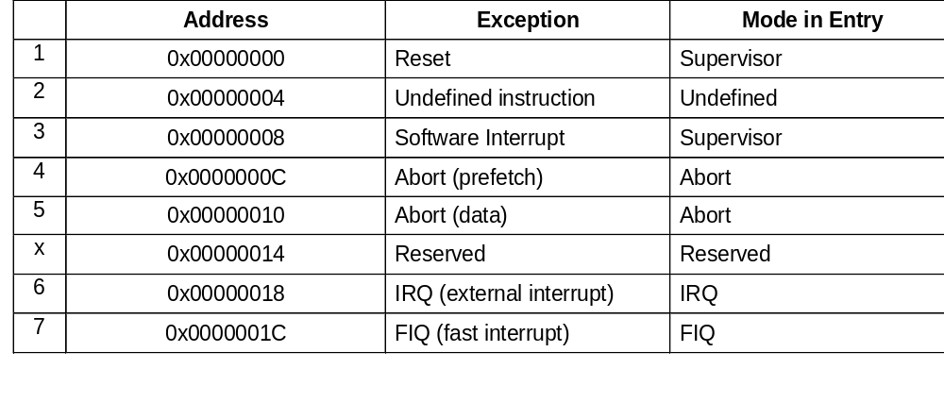
Exception (interrupt) Modes
ARM supports 7 types of exceptions and has a privileged processor mode for each type of exception.
ARM Exception (interrupt) vectors
SWI
IRQ

Slide 10
Different types of exceptions
Reset (supervisor model, at power up , or reset button depressed)
Undefined Instruction (for co-processors *)
*Prefetch Abort for instruction fetch memory fault
*Data Abort : for data access memory fault
Software Interrupt (SWI) : supervisor mode, operating sys. calls
FIQ (Fast interrupt request)
IRQ (interrupt request)
* not discussed here , refer to
http://infocenter.arm.com/help/topic/com.arm.doc.ddi0210c/DDI0210B.pdf

Slide 11
common usage of exceptions
For building operating systems
  Reset (supervisor model, at power up , or reset button depressed)
  Undefined Instruction (for co-processors *)
  *Prefetch Abort for instruction fetch memory fault
  *Data Abort: for data access memory fault
  Software Interrupt (SWI) : supervisor mode, operating sys. calls
For embedded systems, hardware systems
  FIQ (Fast interrupt request)
  IRQ (interrupt request)
* not discussed here , refer to
http://infocenter.arm.com/help/topic/com.arm.doc.ddi0210c/DDI0210B.pdf

Slide 12
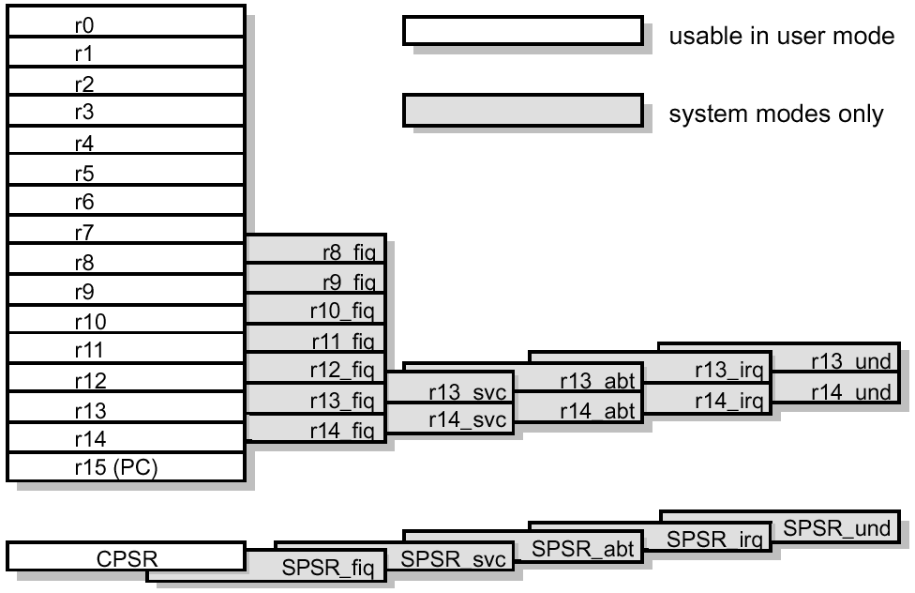
ARM Registers
32-bit

Slide 13
Recall program status regs
Mode of interrupt
31
28
8
4
0
N
Z
C
V
I F T
Mode
Copies of the ALU status flags (latched if the
instruction has the "S" bit set).
* Condition Code Flags
* Interrupt Disable bits.
I = 1, disables the IRQ.
F = 1, disables the FIQ.
* T Bit (Architecture v4T only)
T = 0, Processor in ARM state
T = 1, Processor in Thumb state
N = Negative result from ALU flag.
Z = Zero result from ALU flag.
C = ALU operation Carried out
V = ALU operation oVerflowed

Slide 14
Recall: registers
General registers and Program Counter
User32 / System
FIQ32
Supervisor32
Abort32
IRQ32
Undefined32
r0
r0
r0
r0
r0
r0
r1
r1
r1
r1
r1
r1
r2
r2
r2
r2
r2
r2
r3
r3
r3
r3
r3
r3
r4
r4
r4
r4
r4
r4
Shaded
registers
are extra
Registers
for different
modes
r5
r5
r5
r5
r5
r5
r6
r6
r6
r6
r6
r6
r7
r7
r7
r7
r7
r7
r8
r8_fiq
r8
r8
r8
r8
r9
r9_fiq
r9
r9
r9
r9
r10
r10_fiq
r10
r10
r10
r10
r11
r11_fiq
r11
r11
r11
r11
r12
r12_fiq
r12
r12
r12
r12
r13 (sp)
r13_fiq
r13_svc
r13_abt
r13_irq
r13_undef
r14 (lr)
r14_fiq
r14_svc
r14_abt
r14_irq
r14_undef
r15 (pc)
r15 (pc)
r15 (pc)
r15 (pc)
r15 (pc)
r15 (pc)
Program Status Registers
cpsr
cpsr
cpsr
cpsr
cpsr
cpsr
sprsr_fiq
sprsr_fiq
sprsr_fiq
sprsr_fiq
sprsr_fiq
spsr_fiq
spsr_svc
spsr_abt
sprsr_fiq
sprsr_fiq
sprsr_fiq
sprsr_fiq
sprsr_fiq
spsr_irq
spsr_undef
sprsr_fiq
sprsr_fiq
sprsr_fiq
sprsr_fiq
SPSR= Saved Process
Status Reg
sprsr_fiq

Slide 15
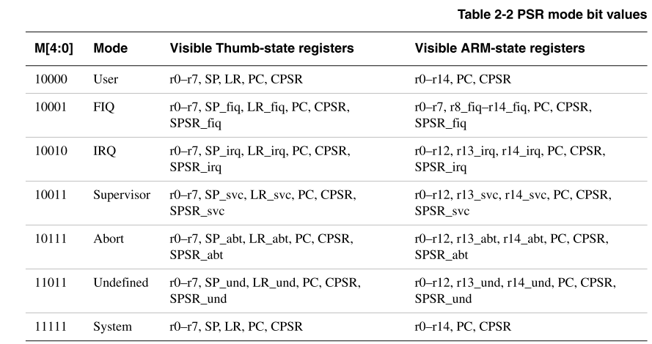
Mode bits M[0:4] : bit0->bit4 of CPSR
31
28
8
4
0
N
Z
C
V
I F T
Mode
http://infocenter.arm.com/help/topic/com.arm.doc.ddi0210c/DDI0210B.pdf

Slide 16
We will study Software Interrupt
(SWI)

Slide 17
Why Software interrupt SWI?
“Similar to a subroutine call but more efficient and organized”
Make a list of often used routines
To build system calls in Linux or Windows.
E.g. print character , read keyboard etc..

Slide 18
SWI software interrupt
For operating sys. (OS) developers to write often used routines
E.g. SWI 0x12 is for “write a character to screen”
So you may have a table of all routines and called by users or OS programs.
SWI table
0x01= reset system
0x02= init timer
:
0x12 = write a charter to screen
0x13= make a beep sound for 0.5 seconds…

Slide 19

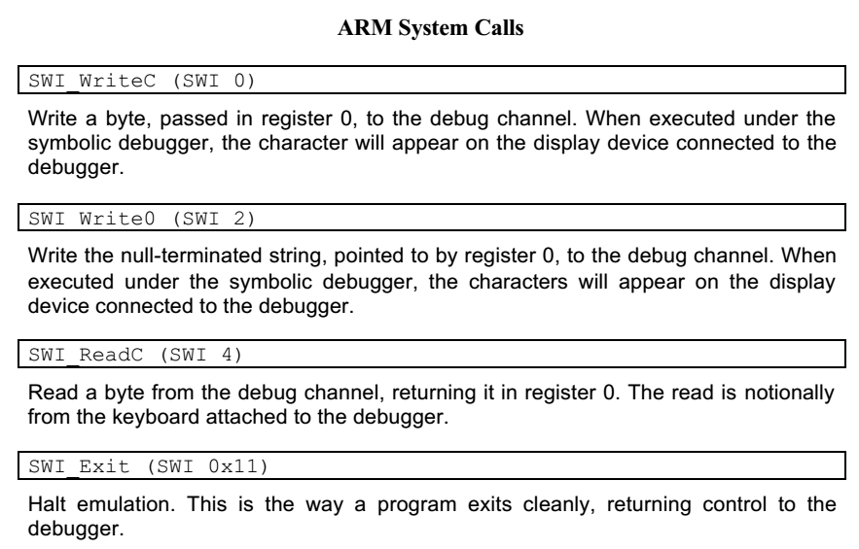
SWI software interrupt

Slide 20
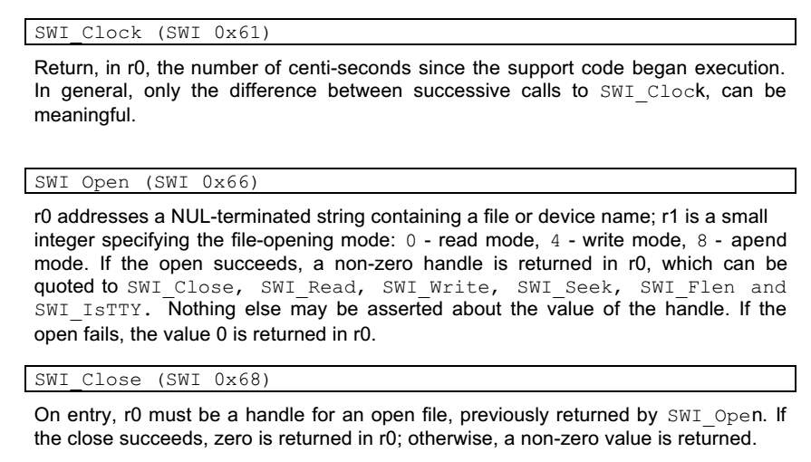
SWI software interrupt

Slide 21
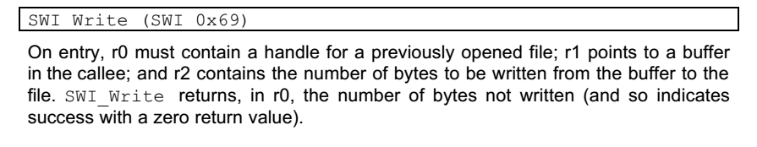
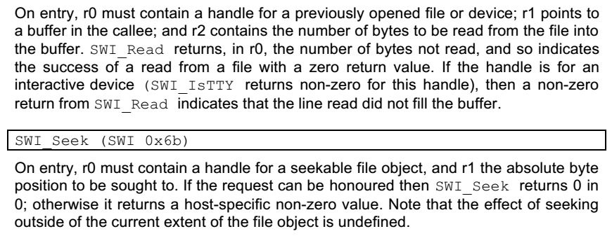
SWI software interrupt

Slide 22
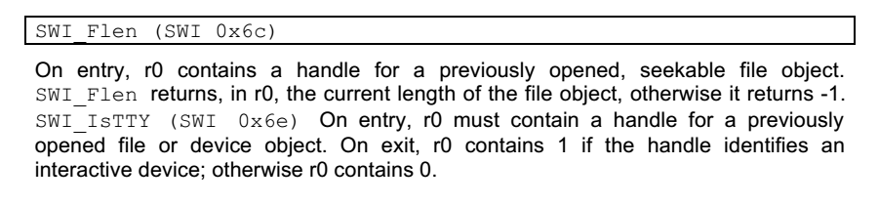
SWI software interrupt

Slide 23
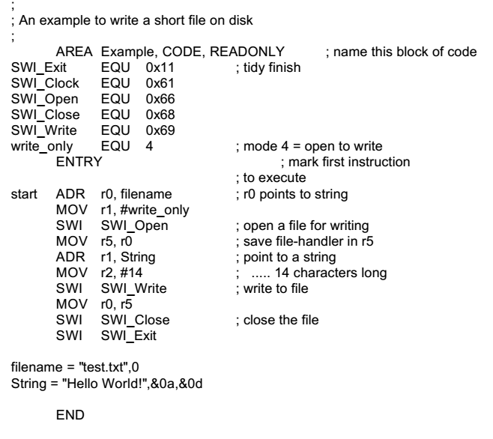
SWI software interrupt

Slide 24
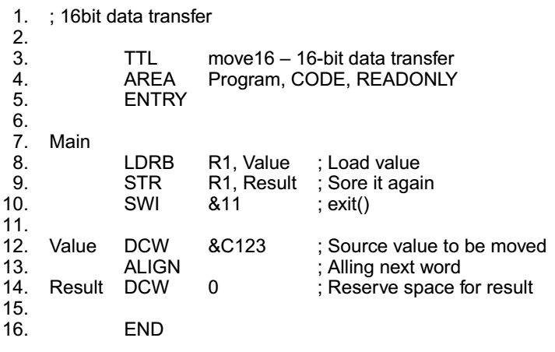

Slide 25
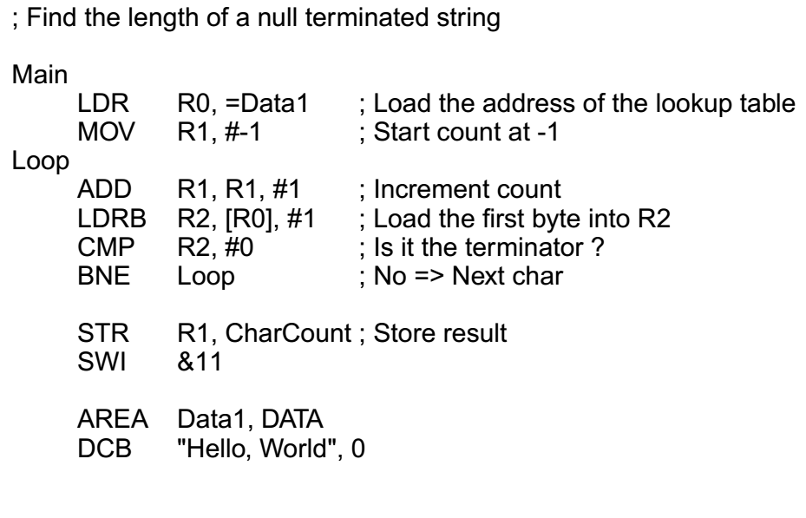

Slide 26
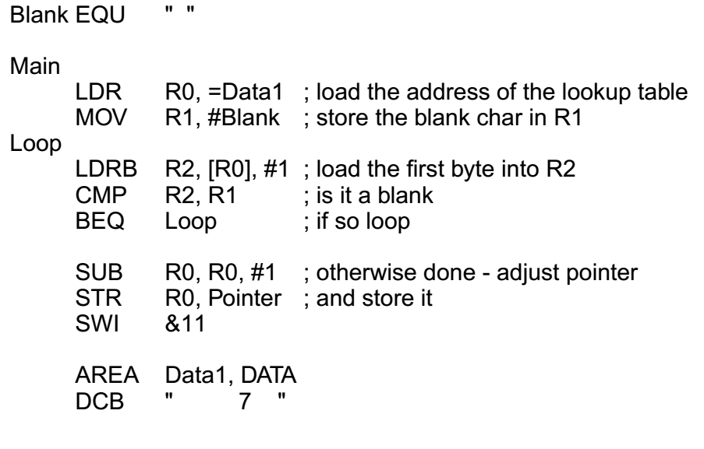

Slide 27
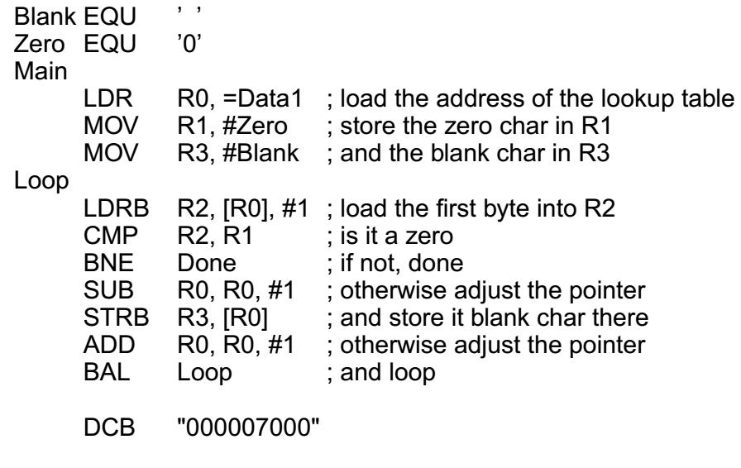

Slide 28
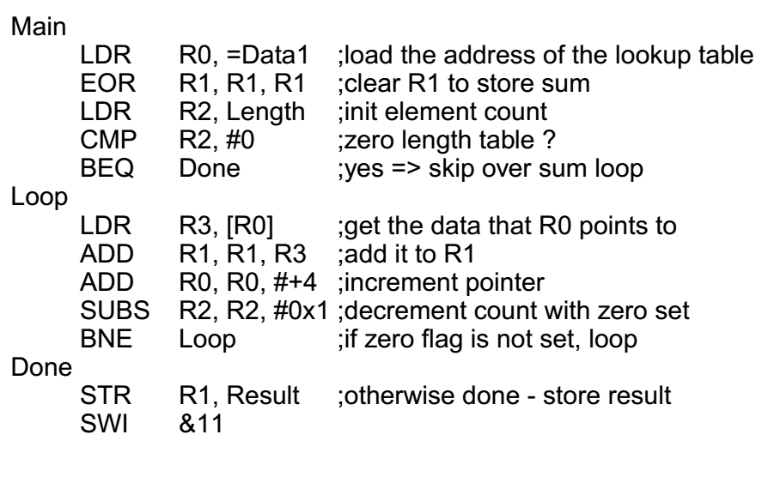

Slide 29
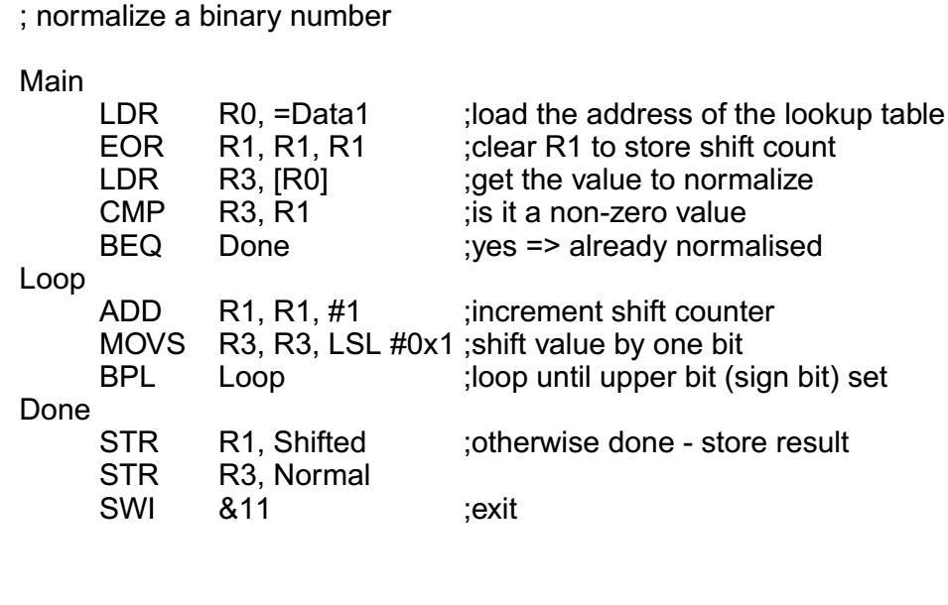

Slide 30
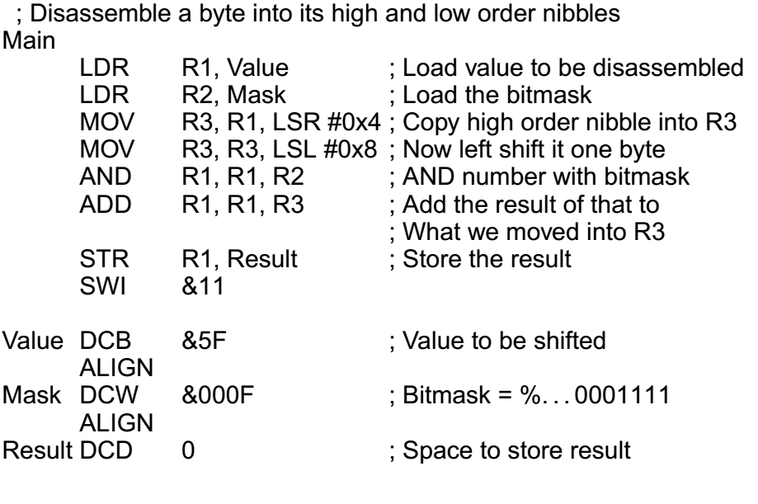

Slide 31
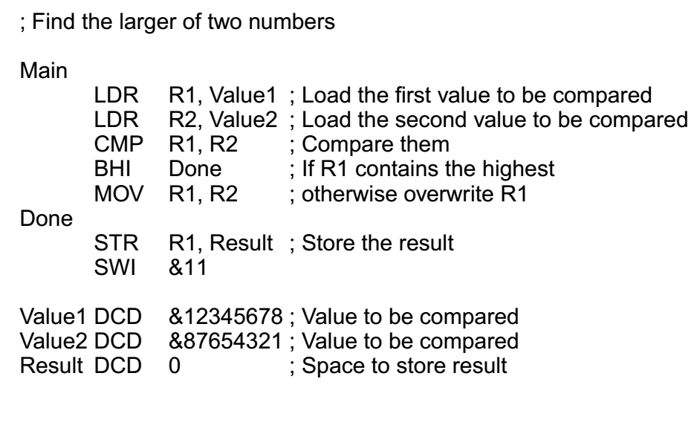

Slide 32
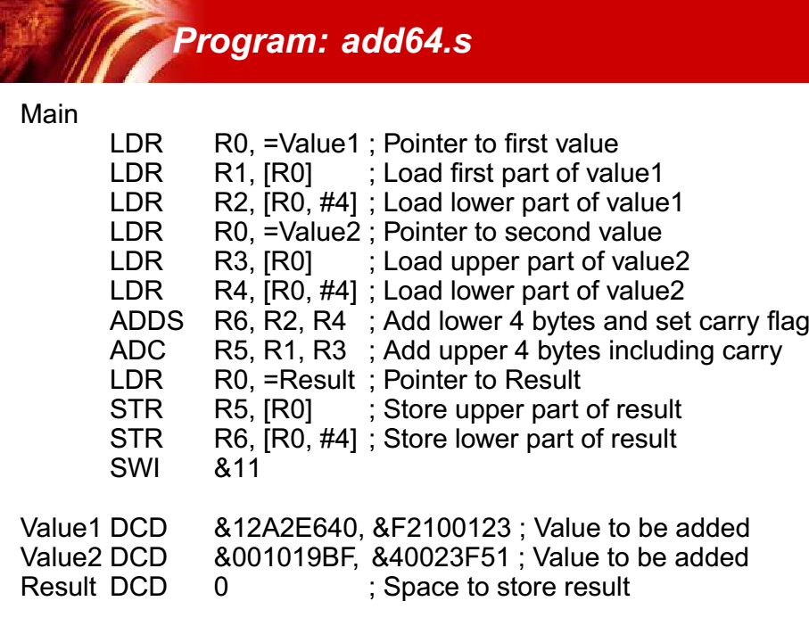

Slide 33
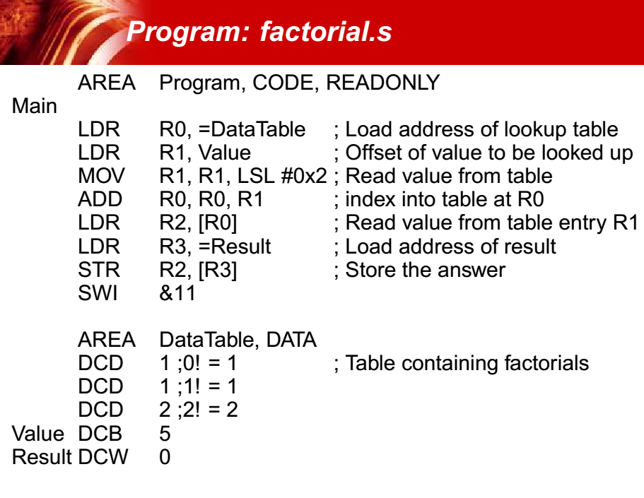

Slide 34
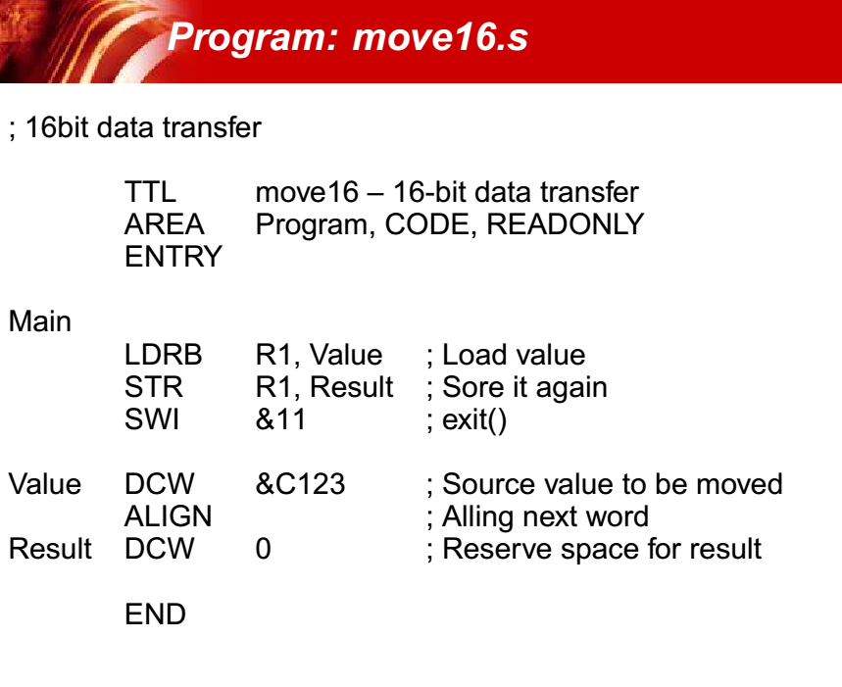

Slide 35
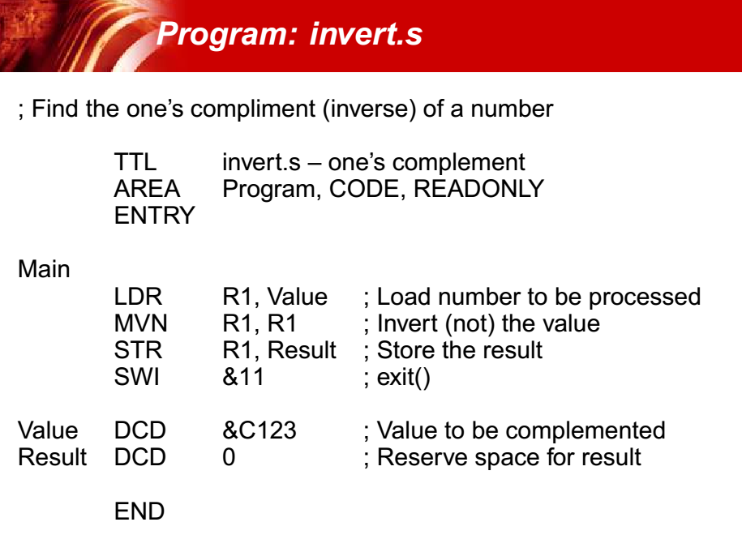

Slide 36
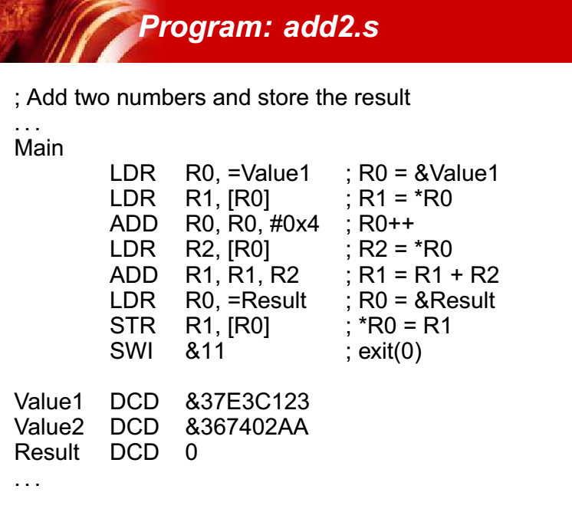

Slide 37
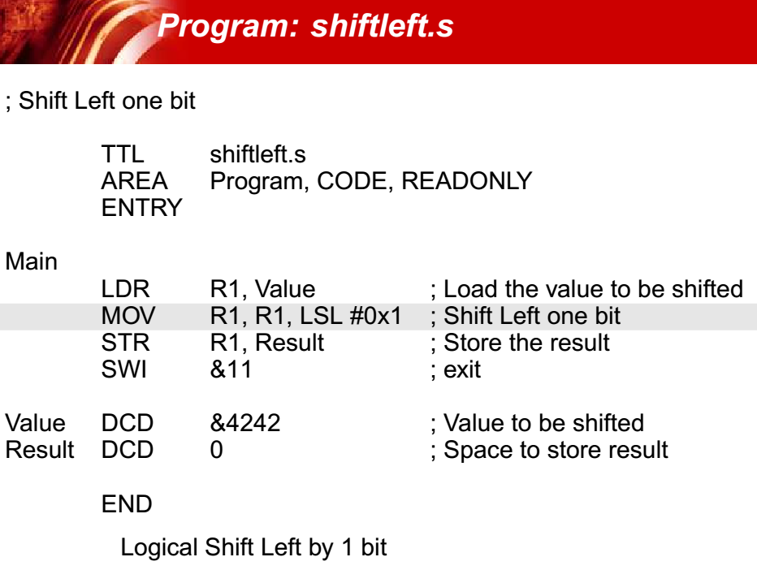

Slide 38
Example
E.g.1 For Building OS Operating system calls
SWI software interrupt for writing OS calls
An efficient way for user to make OS calls
Examples, SWI table
  SWI 20 = Print text on screen
  SWI 23 =Read real time clock
  SWI 35 =Keyboard read
  -……
Main()
{
:
:
:
}
Supervisor mode
SWI x ;software interrupt
Program for SWI x
Print a character
to screen

Slide 39
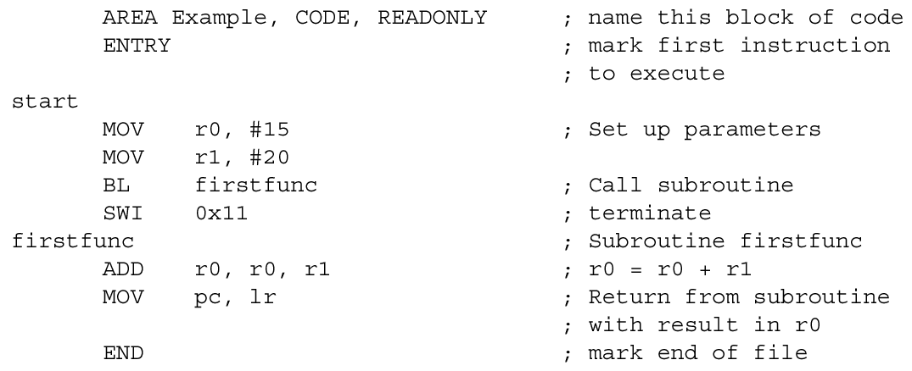
Code Example
When SWI is in your code:
E.g. SWI vector=SWI 0x11, vector =0x11

Slide 40
SWI interrupt procedures
(enter the supervisor mode)
SWI (software interrupt )
  Caused by “SWI 0x??” in your program
  Arm completes the current instruction.
  Goto SWI exception address 0x08 (short form for 0x000 0008)
  Exception entry, execution procedure (see next slide)
  {Change to supervisor op. mode :CPSR (bit0-4)
  :
  :
  Return from interrupt
    MOVS pc, lr
  return to main}

Slide 41


Details of entering an interrupt (exception)
Preserves the address of the next instruction in the appropriate Link Register (e.g. r14_svc → r14 of supervisor mode)
Copies the CPSR (Current Program Status Register ) into the appropriate SPSR (Saved Process Status Reg. e.g. SPSR_svc)
Forces the CPSR mode bits to a value which depends on the exception (supervisor, interrupt etc)
Forces the PC (program counter r15) to fetch the next instruction from the relevant exception vector
It may also set the interrupt disable flags to prevent otherwise unmanageable nesting of exceptions.
http://infocenter.arm.com/help/topic/com.arm.doc.ddi0210c/DDI0210B.pdf

Slide 42
SWI Software interrupt
For your reference: SWI Software interrupt execution flow
On SWI, the processor
    (1) copies CPSR to SPSR_SVC
    (2) sets the CPSR mode bits to supervisor mode
    (3) sets the CPSR IRQ to disable
    (4) stores the value (PC + 4) into LR_SVC
    (5) forces PC to 0x08
Warning:
What was in R0? User program may have been using this register. Therefore, cannot just use it ­ must first save it first (push stack)
Usage of BIC (Bit Clear)
E.g. BIC R0, R0, #%1011 ;
Clear bit-0, bit-1, bit-3 in R0.
Vector Table (spring board)
starting at 0x00 in memory
USER Program:0x40002000
SWI Handler:0x40001000
(S_Handler)
0x00
0x04
0x08
0x0c
0x10
0x14
0x18
0x1c
to R_Handler
to U_Handler
to S_Handler
to P_Handler
to D_Handler
...
to I_Handler
to F_Handler
(Reset
(Undef instr.)
(SWI)
(Prefetch abort)
(Data abort)
(Reserved)
(IRQ)
(FIQ)
ADD r0,r0,r1
SWI 0x02
SUB r2,r2,r0
LDR r0,[lr,#­-4]
BIC r0,r0,#0xff000000
// now the vector is in r0
switch (r0){
case 0x00: service_SWI1();
case 0x01: service_SWI2();
case 0x02: service_SWI3();
…
}
MOVS pc, lr
From
www.cs.ucr.edu/~amitra/context_switch/extra/04_swi.ppt

Slide 43
Exercise 12.2: SWI handler : Assume the SWI handler is at 0x40001000
i) What is the content of address 0x08? Why?
Answer:?__________________________________________
ii) What will the Processor do when it runs SWI 0x02
Fill in steps that the precessor will do when entering SWI
Step1:_________________
Step2 :_________________
Step3 :_________________
Step4 :_________________
Step5:__________________
User main program (from 0x40002000)
Address | instruction
0x40002000 | ADD r0,r0,r1
0x40002004 | SWI 0x02
0x40002008 | SUB r2,r2,r0
SWI handler (from 0x40001000)
:push registers onto stack
LDR r0,[lr,#­-4]
BIC r0,r0,#0xff000000 :swtch(r0) .. etc :
:pop registers from stack
MOVS pc, lr; return from interrupt

Slide 44
Exercise 12.3 SWI handler
Inside the SWI handler
  i) What are the mode bits M[0:4] : bit0->bit4 of CPSR? Answer: ?______________
  Ii) What is the running mode inside the SWI handler: supervisor or user32?
    ANSWER: ?___________________________________
  III) When the link register lr is used, which lr the processor is using :r14(lr) or r14_svc or r14_irq?
    Answer?__________________________________
The Machine code of SWI 0x02 is 0xea000002 . List the values of r0 after the first and second instruction of the SWI handler.
  LDR r0,[lr,#-­4] ; fill in the blank, r0 = ?_______
  BIC r0,r0,#0xff000000; clear most significant 2 bytes of r0; r0=?_____
  // now the vector is in r0
  switch (r0){
  case 0x00: service_SWI1();
  case 0x01: service_SWI2();
  case 0x02: service_SWI3();
  …
  }

Slide 45

Details of leaving an interrupt
ARM7TDMI tech. ref. (section 2.8 exception)[1]
At the end of the SWI handler: Movs pc,lr
Move the r14, minus an offset to the PC. The offset varies according to the type
(auto) SPSR_svc →CPSR.
(auto) Clear the interrupt disable flags that were set on entry
Bye Bye!

Slide 46
Summary
Learned the basic concept of exceptions and interrupts
  SWI (Software interrupt)

Slide 47
Appendix
Alternative set bit method in “C”
Y=0x1<<21;//left shift 21 bits, this sets bit21=1 and other bits= 0
Before shift
  Y=0x1=0000 0000 0000 0000 0000 0000 0000 0001 (Binary)
After shift
  Y= 0000 0000 0010 0000 0000 0000 0000 0000 (Binary)
    bit 31 bit 21 bit0
  Exercise: set bit 9 of register R to be 1, other bits to be 0.
  Answer=0x1<<9;
  So R=0000 0000 0000 0000 0000 0010 0000 0000 (Binary)
  =0x200
Bit9 =1

